Slide 1
Smart Nose Surgery
Team 1:
Chris Graziano, Victoria Jordan, Anton Kiselev,
Jacob Preseau, Chintan Thakrar

Slide 2
Overview
1
Sprint 1 Recap
2
Sprint 2 Progress
3
Sprint 2 Demo Video
4
Sprint 3 Goals

Slide 3
Sprint 1 Results
Developed KNN
Developed facial features extractions
Created dataset of faces
Developed base window for the app

Slide 4
Sprint 2 Current Progress
Developed versions 0.0.1 through 0.0.3
Algorithms were combined in one app
App allows user to upload or take a picture from a webcam
App will extract facial features using dlib library, calculate facial ratios for width and height
Use those ratios for KNN to find K (5, test purpose only) numbers of neighbors
Display K number of faces in-app window
Notes:
I’ll talk through points one and two

Slide 5
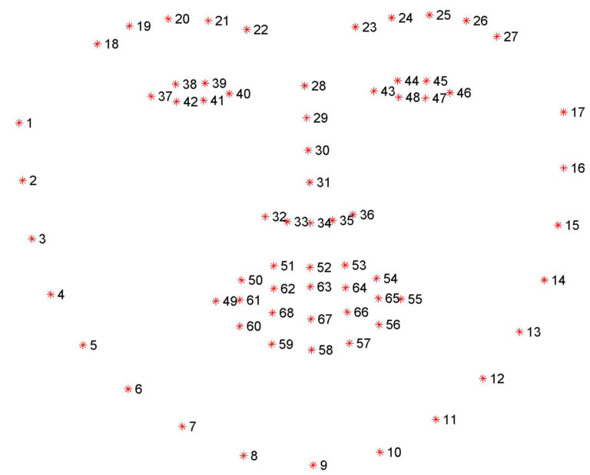
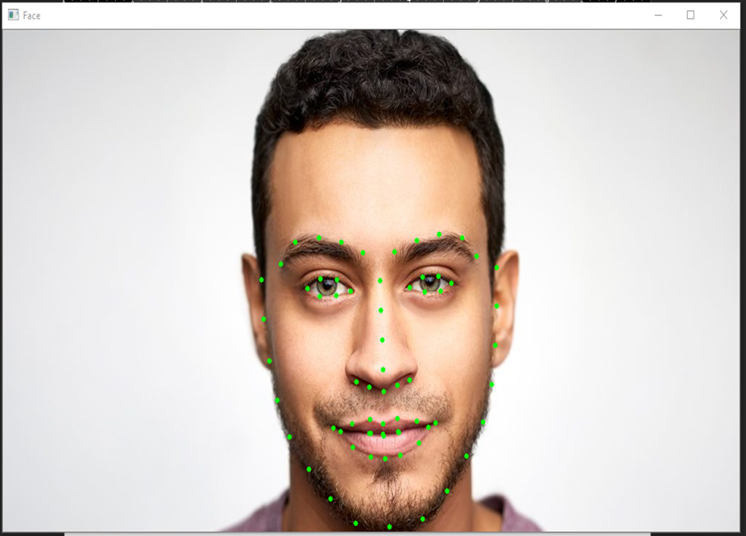
Facial Features Extraction Algorithm Details

Slide 6
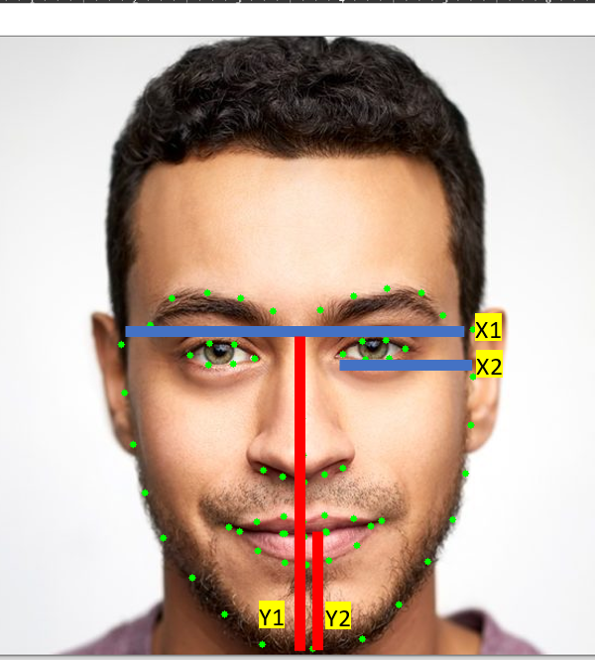
Facial Ratio Calculation
X ratio = X1 / X2
Y ratio = Y1 / Y2
Results used for KNN
Each face has unique ratio number

Slide 7
Sprint 2 Demo Video

Slide 8
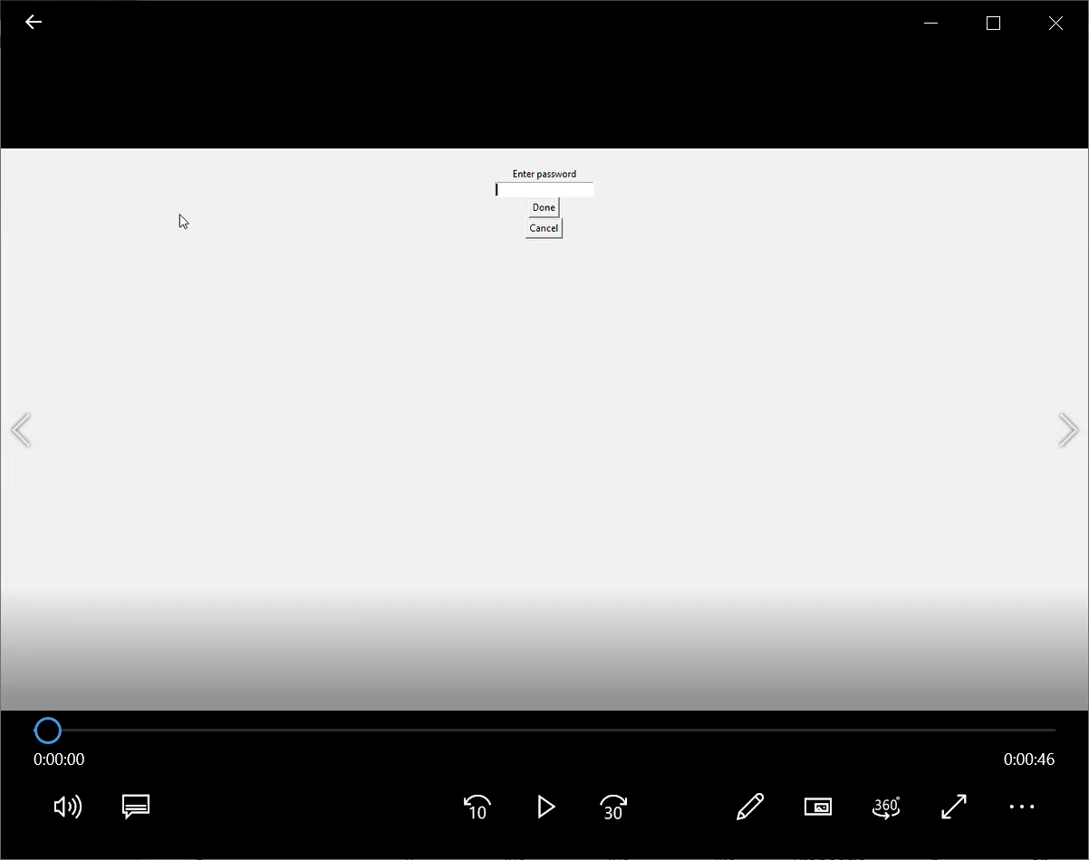
Notes:
Chris and Victoria talk here

Slide 9
Sprint 3 Goals
Develop algorithm to compare nose points
Develop algorithm to calculate differences
Develop algorithm to display picture with required changes
Test plan
Other visual components for the app

